Slide 1
Adversarially Reweighted Learning
Presented By: Shai Feldman and Guy Shapira

Slide 2
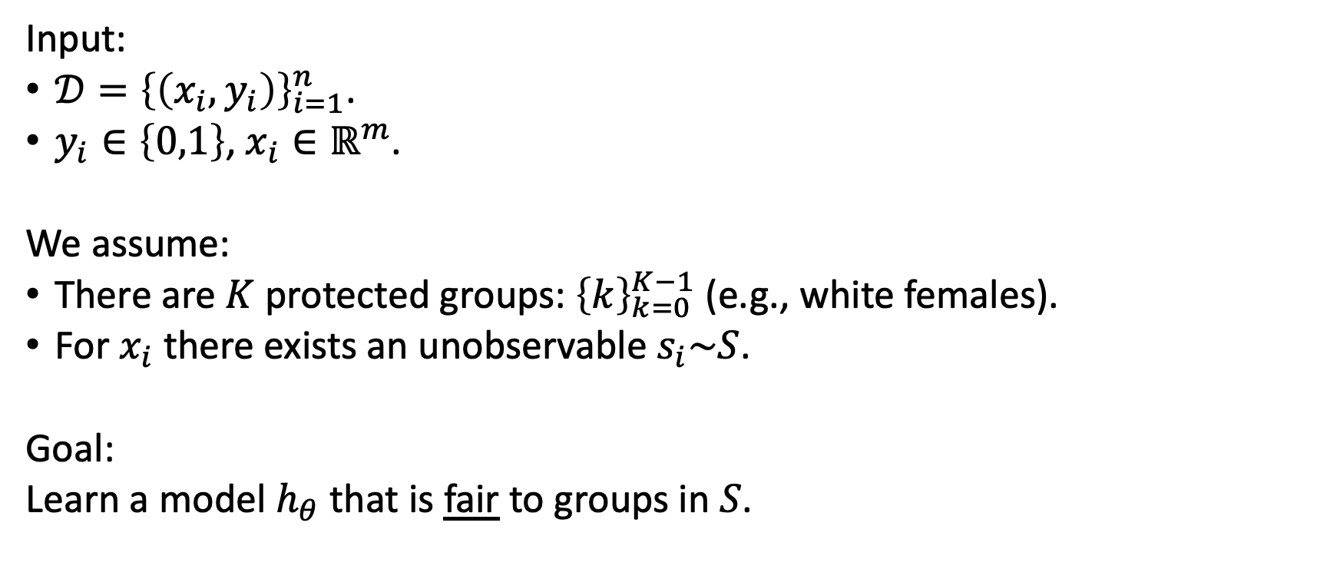
Problem formulation
Input:
$𝒟={\left\{\left(x_{i},y_{i}\right)\right\}}_{i=1}^{n}$.
$y_{i}∈\left\{0,1\right\}$, $x_{i}∈ℝ^{m}$.
We assume:
There are $K$ protected groups: ${\left\{k\right\}}_{k=0}^{K−1}$ (e.g., white females).
For $x_{i}$there exists an unobservable $s_{i}\sim S$.
Goal:
Learn a model $h_{θ}$ that is fair to groups in $S$.

Slide 3
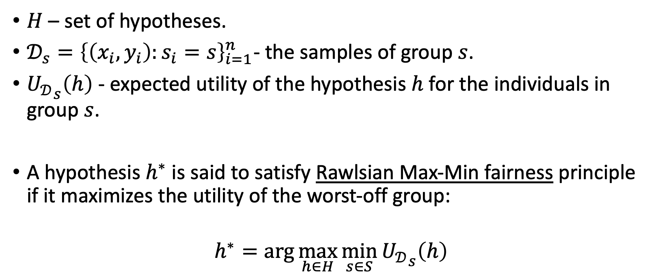
Fairness definition (Rawlsian Max-Min)
$H$ – set of hypotheses.
$𝒟_{s}={\left\{\left(x_{i},y_{i}\right):s_{i}=s\right\}}_{i=1}^{n}$- the samples of group $s$.
${U_{𝒟}}_{s}\left(h\right)$ - expected utility of the hypothesis $h$ for the individuals in group $s$.
A hypothesis $h^{∗}$ is said to satisfy Rawlsian Max-Min fairness principle if it maximizes the utility of the worst-off group:
$$h^{∗}=\arg{\max_{h∈H}{\min_{s∈S}{{U_{𝒟}}_{s}\left(h\right)}}}$$

Slide 4
Adversarial Reweighted Learning - Motivation
Train set losses
Learner
Adversary
Predict a protected group
Learn using the reweighted loss
Larger weights on the protected group
High loss over a specific group
The adversary assigns larger weights for that group
The learner strives to predict better over that group

Slide 5
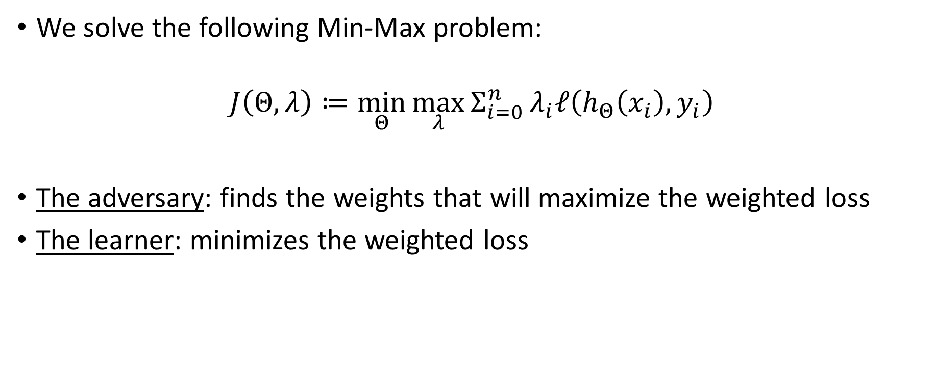
Adversarial Reweighted Learning
We solve the following Min-Max problem:
$$J\left(Θ,λ\right)≔\min_{Θ}{\max_{λ}{Σ_{i=0}^{n}}λ_{i}ℓ\left(h_{Θ}\left(x_{i}\right),y_{i}\right)}$$
The adversary: finds the weights that will maximize the weighted loss
The learner: minimizes the weighted loss

Slide 6
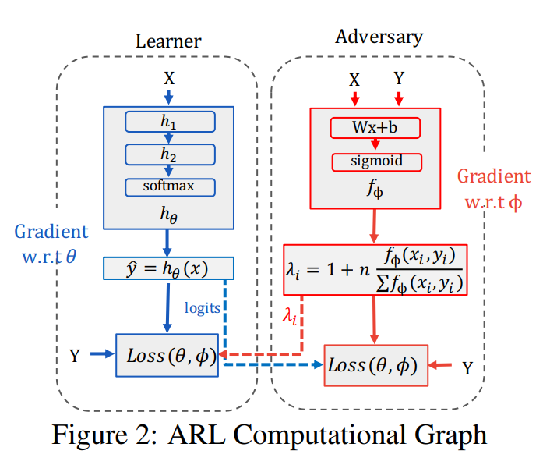
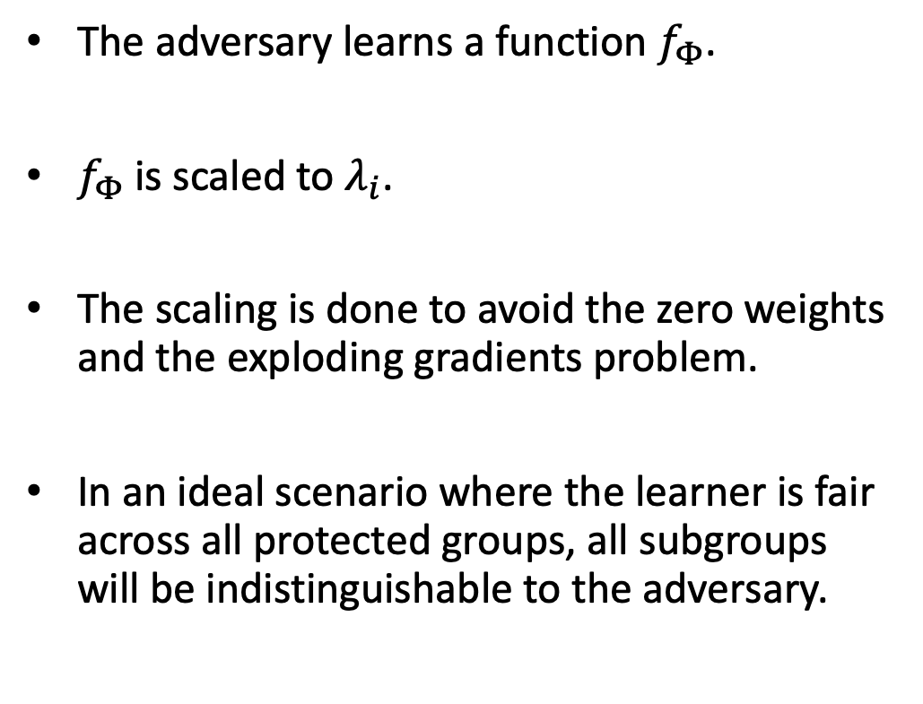
Adversarial Reweighted Learning
The adversary learns a function $f_{Φ}$.
$f_{Φ}$is scaled to $λ_{i}$.
The scaling is done to avoid the zero weights and the exploding gradients problem.
In an ideal scenario where the learner is fair across all protected groups, all subgroups will be indistinguishable to the adversary.

Slide 7
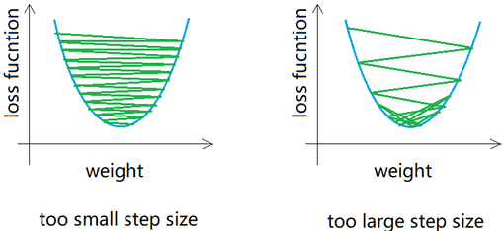
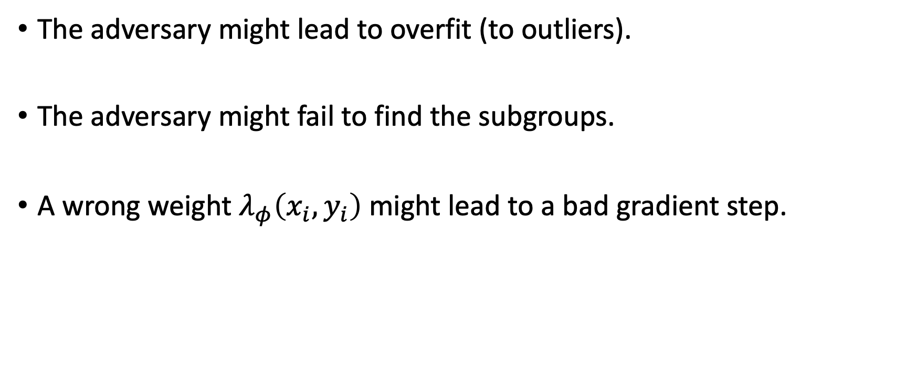
ARL limitations
The adversary might lead to overfit (to outliers).
The adversary might fail to find the subgroups.
A wrong weight $λ_{φ}\left(x_{i},y_{i}\right)$ might lead to a bad gradient step.

Slide 8
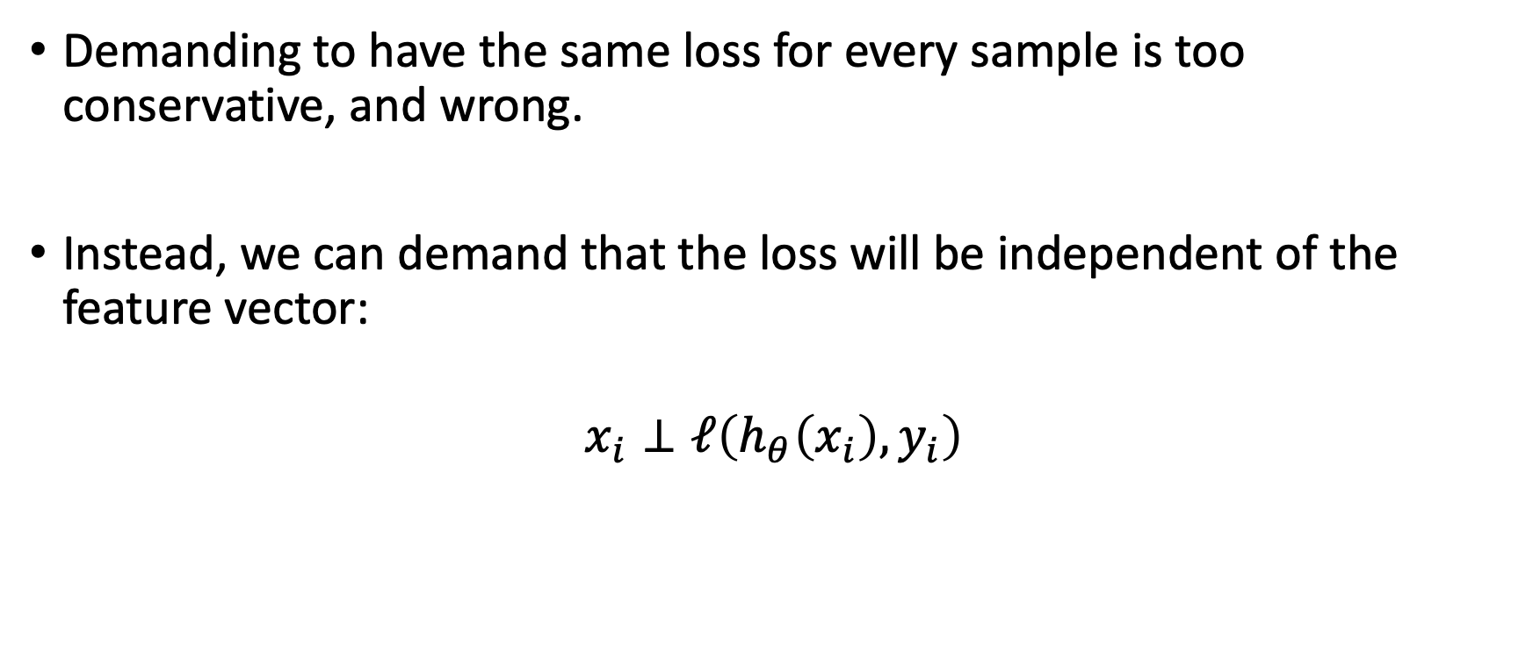
Improving methods motivations
Demanding to have the same loss for every sample is too conservative, and wrong.
Instead, we can demand that the loss will be independent of the feature vector:
$$x_{i}⊥ℓ\left(h_{θ}\left(x_{i}\right),y_{i}\right)$$

Slide 9
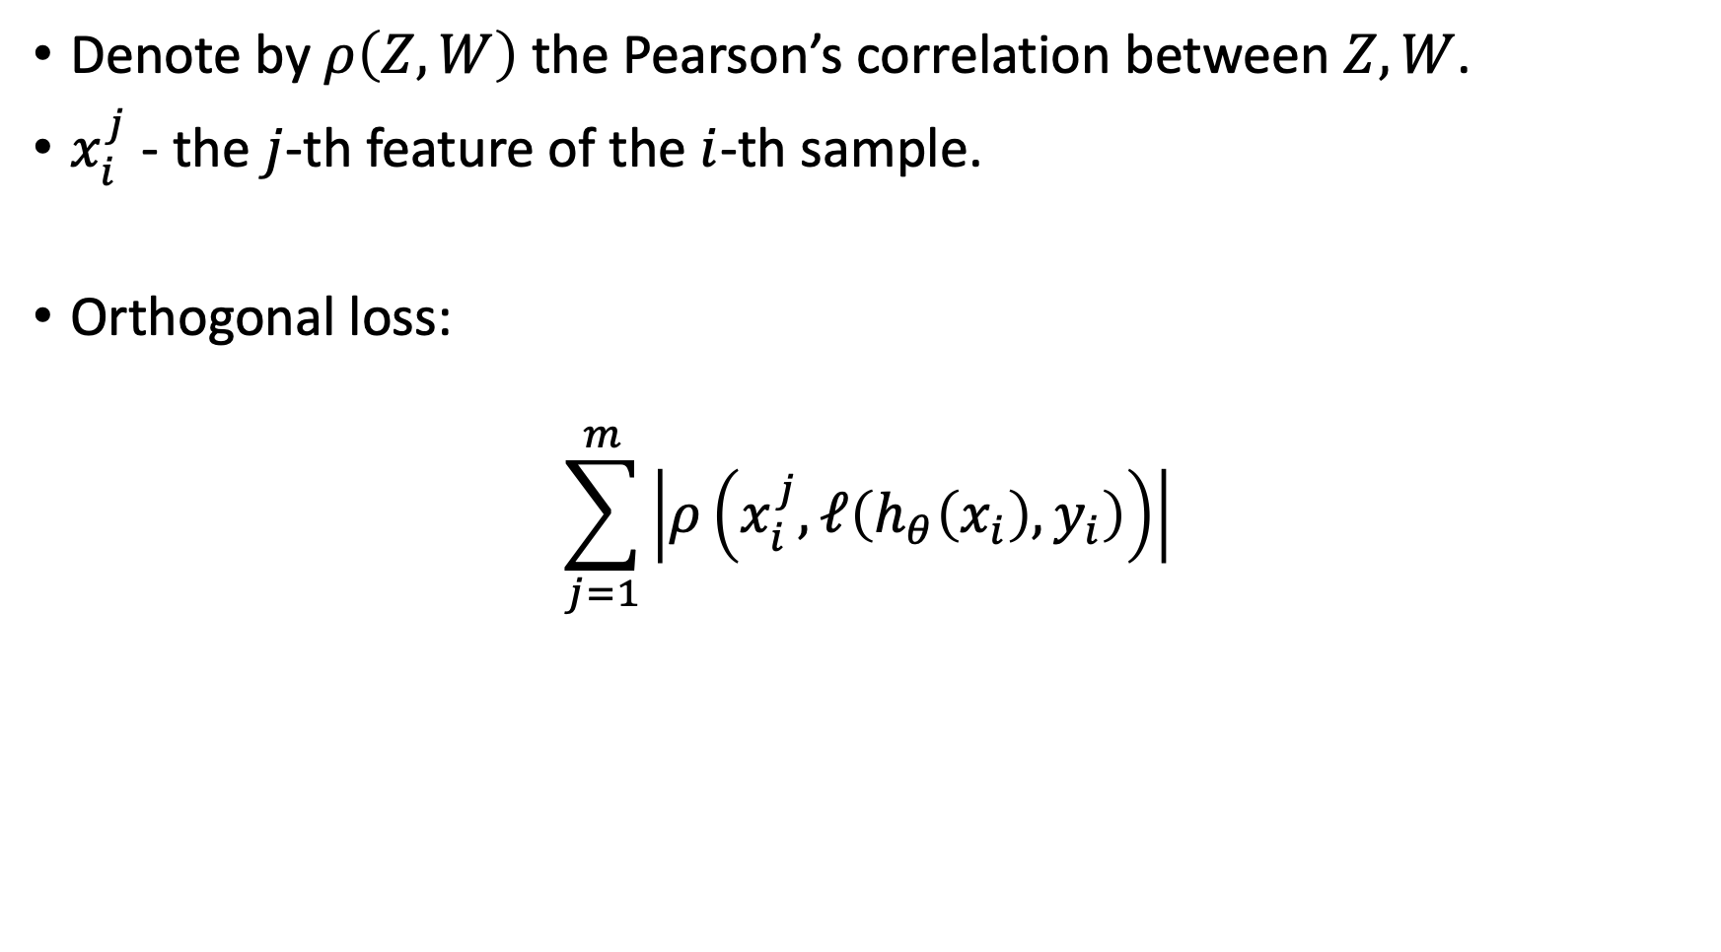
Adversarial Orthogonal Learning (AOL)
Denote by $ρ\left(Z,W\right)$ the Pearson’s correlation between $Z,W$.
$x_{i}^{j}$ - the $j$-th feature of the $i$-th sample.
Orthogonal loss:
$$\sum_{j=1}^{m}{\left|ρ\left(x_{i}^{j},ℓ\left(h_{θ}\left(x_{i}\right),y_{i}\right)\right)\right|}$$

Slide 10
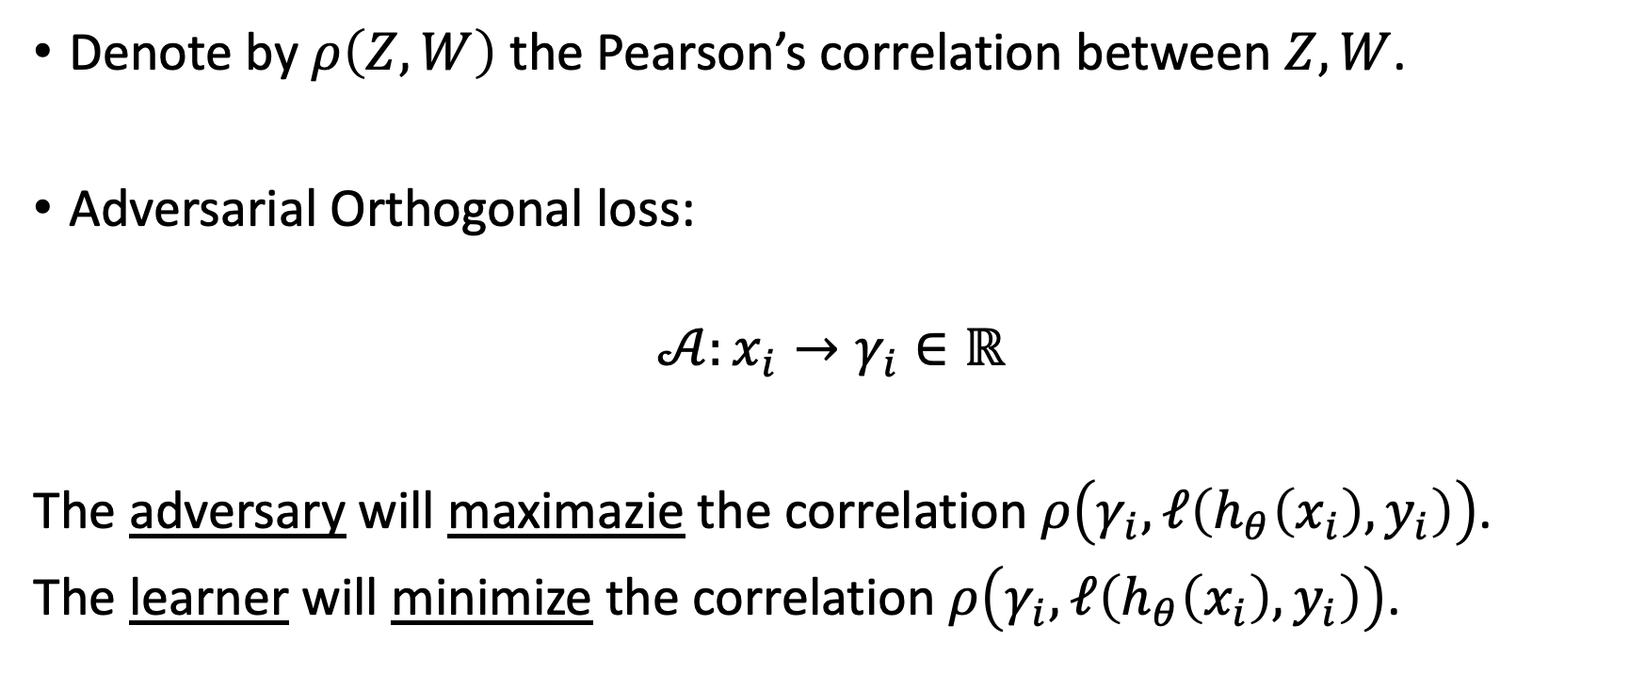
Adversarial Orthogonal Learning (AOL)
Denote by $ρ\left(Z,W\right)$ the Pearson’s correlation between $Z,W$.
Adversarial Orthogonal loss:
$$𝒜:x_{i}→γ_{i}∈ℝ$$
The adversary will maximazie the correlation $ρ\left(γ_{i},ℓ\left(h_{θ}\left(x_{i}\right),y_{i}\right)\right)$.
The learner will minimize the correlation $ρ\left(γ_{i},ℓ\left(h_{θ}\left(x_{i}\right),y_{i}\right)\right)$.

Slide 11
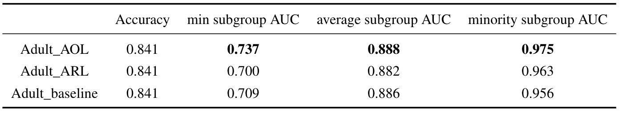
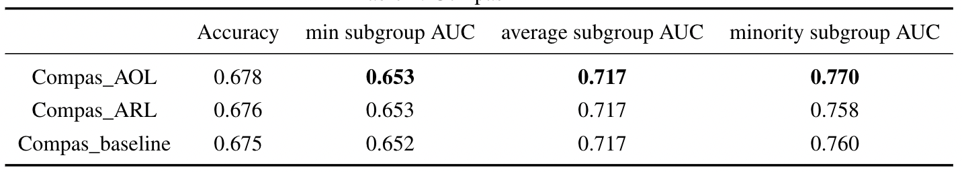
Results
Results averaged over 15 seeds:

Slide 12
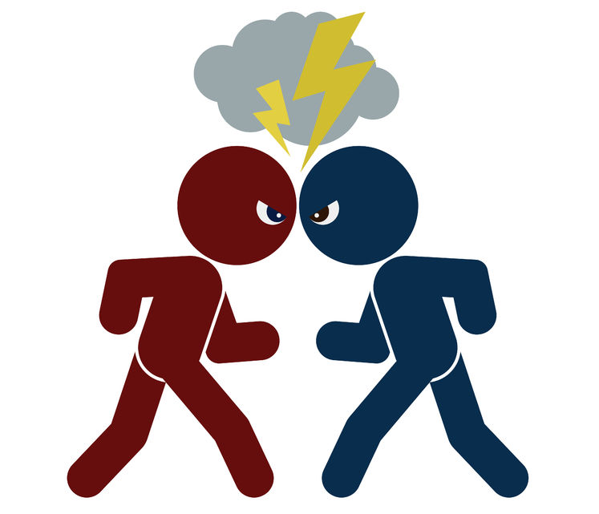
Thanks for listening!
Learner
Adversary

